Slide 1
Visual Question Answering
“VQA”

Slide 2


Table of content
VQA Definition
how does VQA work
VQA important

Slide 3
Visual Question Answering “VQA”
VQA is a challenging task that requires the use of computer vision, natural language processing, and artificial intelligence, and artificial intelligence. The goal of VQA is to create computer programs that can answer questions about visual content like pictures and videos using both visual and textual information.

Slide 4
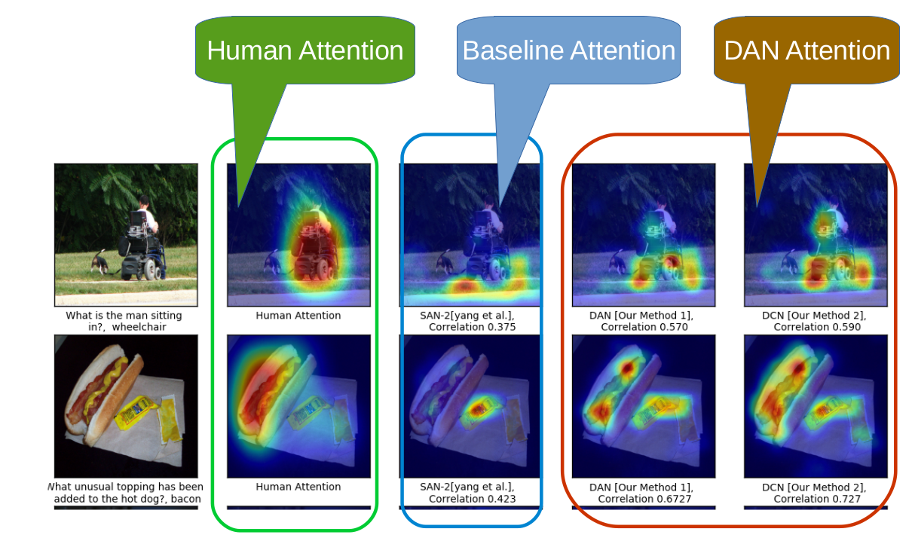

Slide 5
VQA important
Accessibility: VQA can be used to provide assistance to people with visual impairments by answering questions about visual content that they cannot see themselves.
Education: VQA can be used to create interactive educational materials that allow students to ask questions about visual content and receive immediate feedback.
E-commerce: VQA can be used to help customers find products they are looking for by answering questions about product features, such as color, size, and shape.

Slide 6
Thank you
Q/A

